Slide 1
Why We need to choose Data Science ?
Python Life

Slide 2
It is A booming Tech ☺

Slide 3
Highest paying Salaries ☺

Slide 4
More Job Opportunities ☺

Slide 5
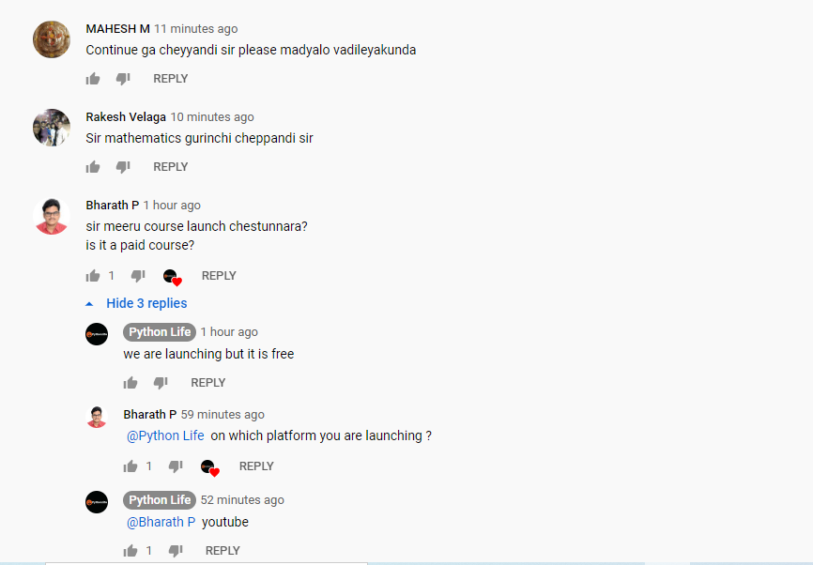
Doubt’s from our students in comments ?

Slide 6
Thanks a lot
Please subscribe our channel

